Slide 1

DEPARTMENT OF COMPUTER SCIENCE & ENGINEERING
SDM INSTITUTE OF TECHNOLOGY
“IoT based Garbage monitoring system and Notification Application”
Under the guidance of
Arjun K
Assistant Professor
Department of CSE
SDMIT, Ujire
Presented By
Darshan D Sutar
Dev Dutt Gowda M J
Hegde Vijay Suryanarayana
Mathin Ahamed
TEAM ID: 2022CSEPT3

Slide 2
INTRODUCTION
In today's world there is an immense growth in the population of the cities due to this rapid urbanization there is a waste collection that leads to various infectious diseases in the environment.
The proposed framework reduces the labor cost and saves time and energy of the system.
The main components we used in making this prototype are Arduino, ESP32 and Ultrasonic Sensors and various detection sensor.
The software component is the application named as Blynk which is used to get notification. This model can be a start to smart dustbin management system in the cities.
.

Slide 3
OBJECTIVES
The objectives of the proposed project are as follows:
Study and Comparative analysis of waste Management.
Designing and Modelling of efficient system for the monitoring of smart bins.
To bring a suitable model so that it can be installed and managed easily and efficiently.
To built an application that is easy to use and understand.

Slide 4
METHODOLOGY
Connection of sensor: The first step is to connect the sensor to the microcontroller, here we are using two microcontrollers, one is the Arduino Uno, and another is ESP32.
Data processing: The next step is to process the code to microcontroller to get the data from respective sensor, here we will be collecting data mainly from ultrasonic sensor.
Sending data to Cloud: After we get data from ultrasonic sensors, we store the data in the cloud, here we are using the Blynk cloud as it is easy to store data and we can develop our application on this cloud and can monitor real time data so it can be easily displayed to the user with friendly interface.

Slide 5
METHODOLOGY
Sending alert message through WhatsApp: Here we will be using WhatsApp to send alert messages to the user, this is done using the Wi-Fi feature present in the ESP32 module, once the bin is full the user will get a message as the dustbin is full.
Google maps for Tracking the bin: By using the neo-6m GPS module and ESP32 will be display the location of the bins which are full so that it can be tracked by the municipal drivers.

Slide 6
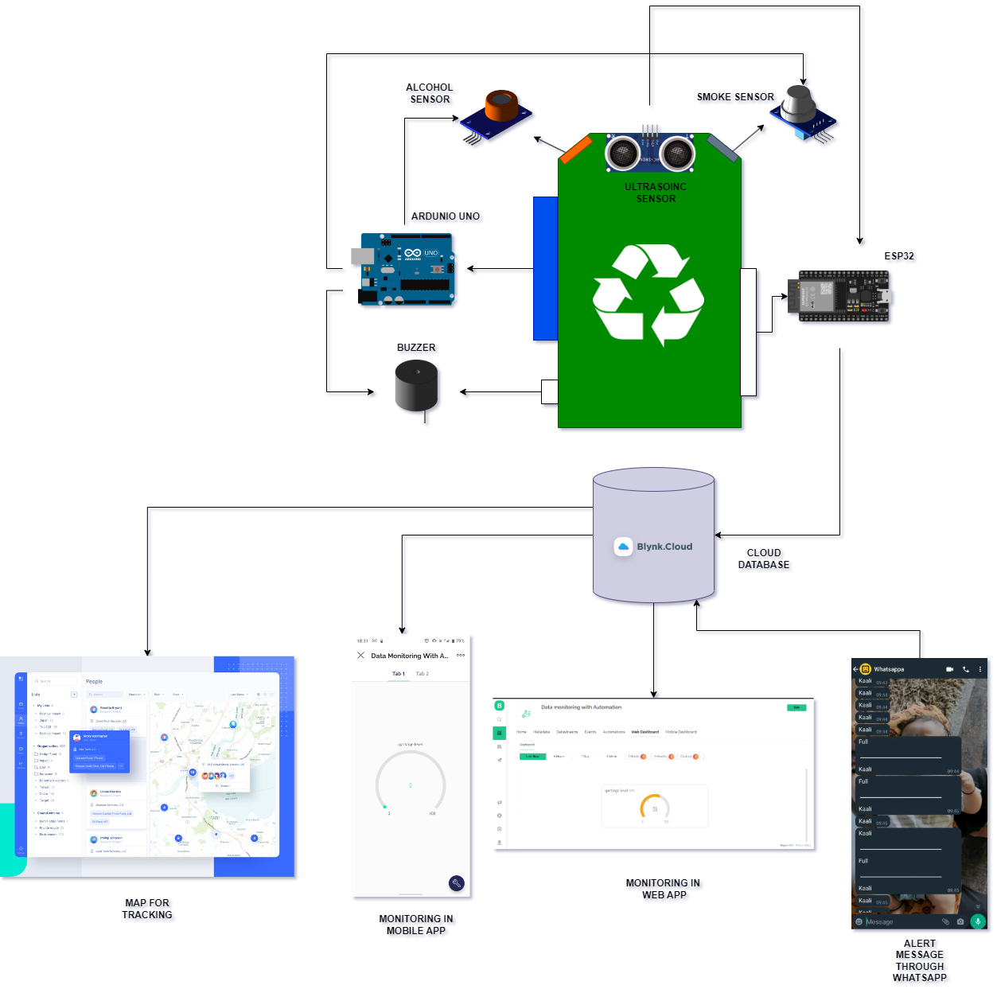
ARCHITECTURE OF THE PROJECT

Slide 7
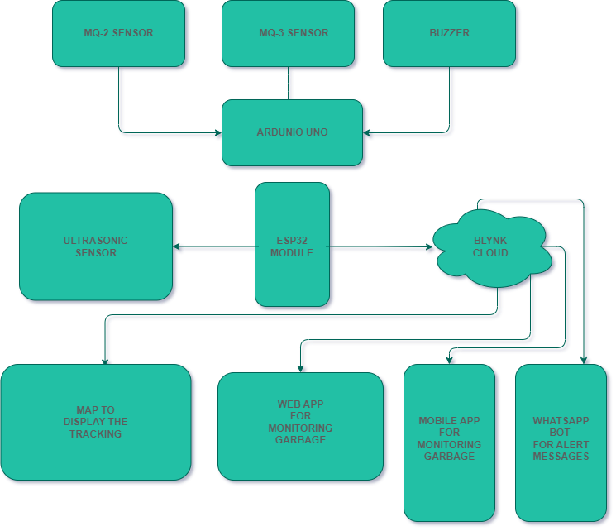
SYSTEM FLOWCHART

Slide 8
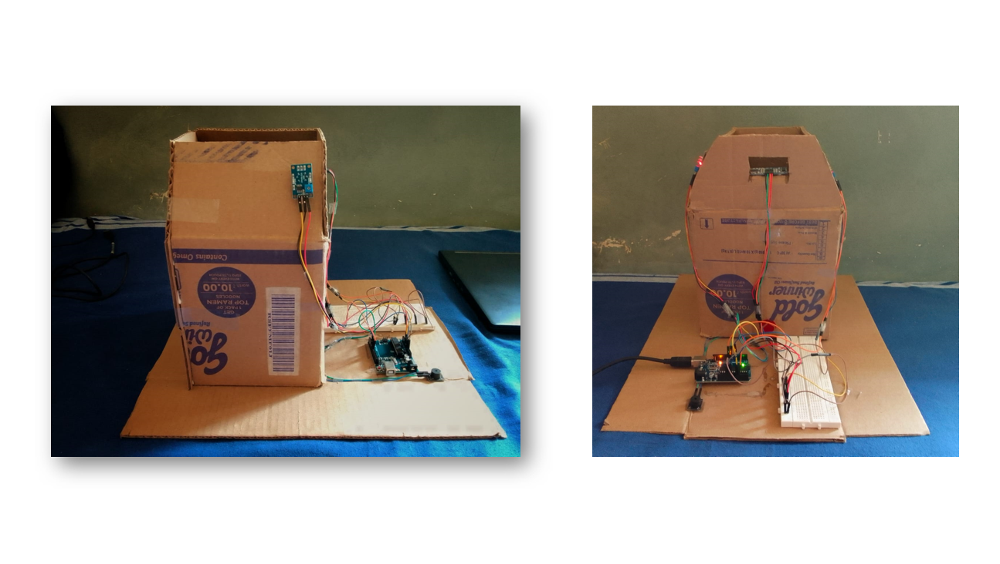
SNAPSHOTS OF PROJECT

Slide 9
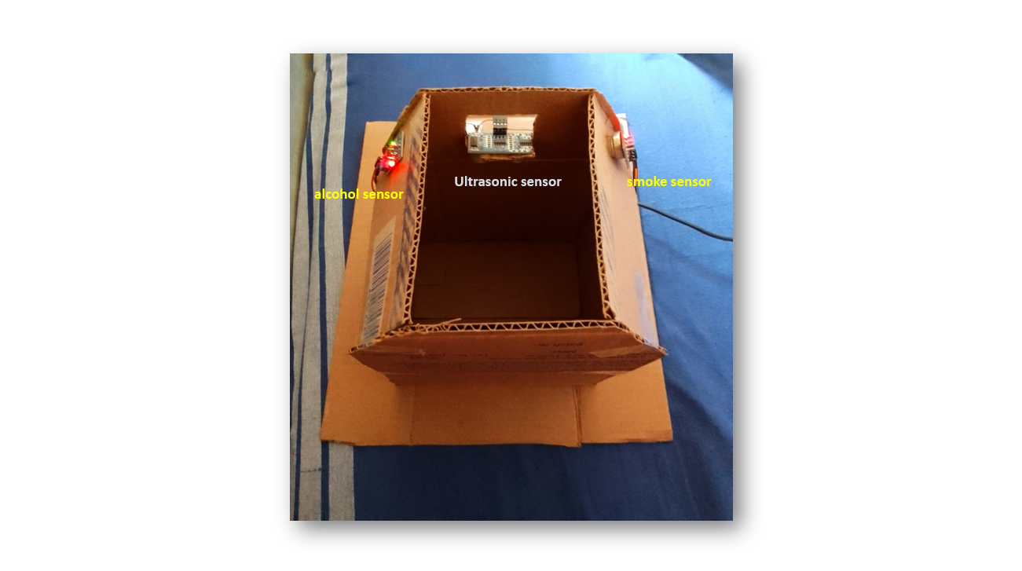
SNAPSHOTS OF PROJECT

Slide 10
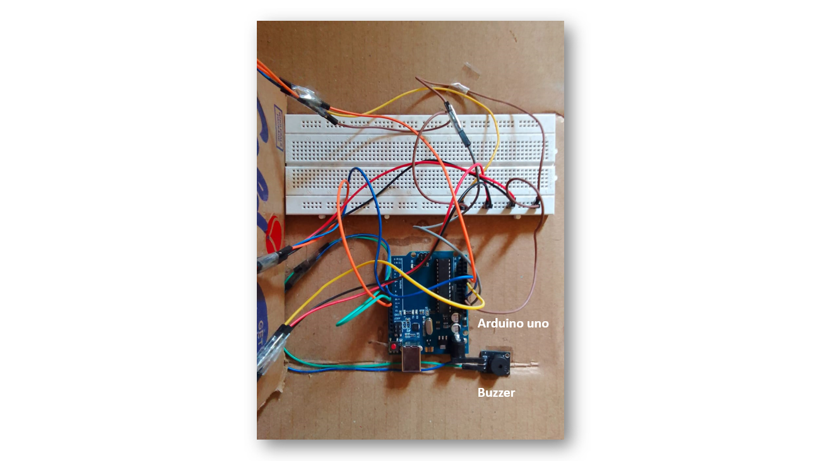
SNAPSHOTS OF PROJECT

Slide 11
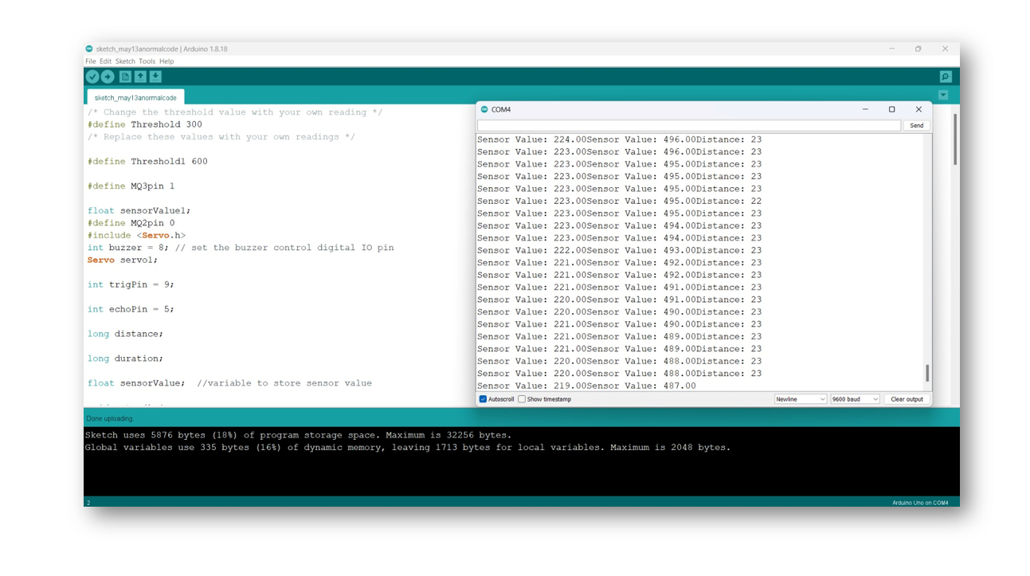
SNAPSHOTS OF PROJECT

Slide 12
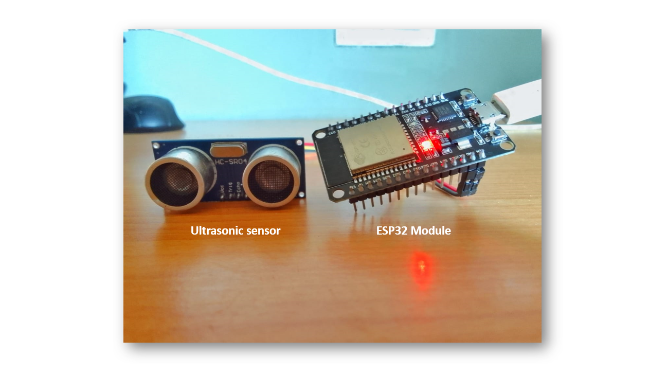
SNAPSHOTS OF PROJECT

Slide 13
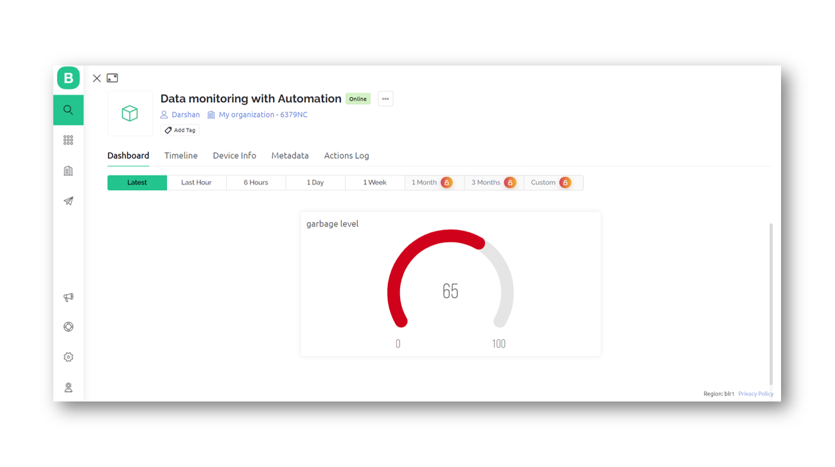
SNAPSHOTS OF PROJECT

Slide 14
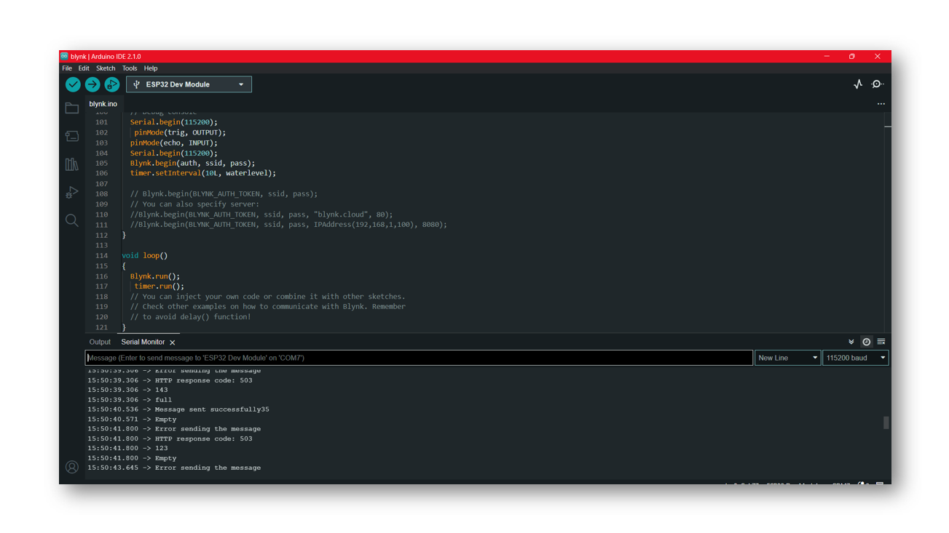
SNAPSHOTS OF PROJECT

Slide 15
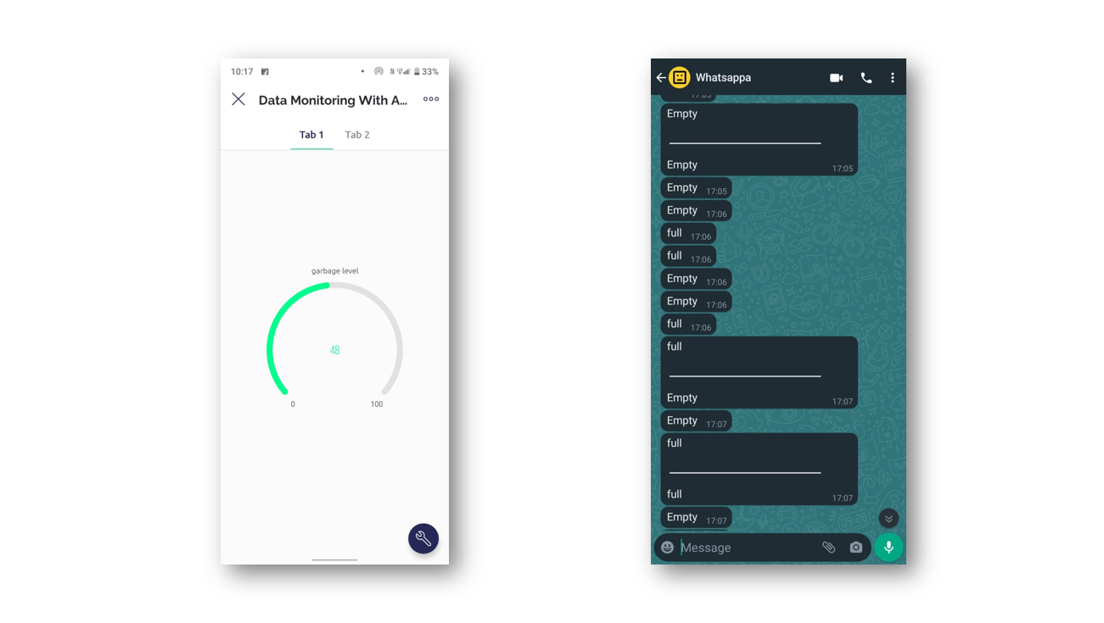
SNAPSHOTS OF PROJECT

Slide 16
CONCLUSION
Today most of the cities need an effective way to segregate the waste as possible so that the cleanliness is maintained throughout their surrounding bins. The two main factors contributing to pollution are the rapid growth of the population and the expansion of industry. Extreme health risks for the community are posed by trash left in the streets and overflowing dustbins. These issues can be solved by utilizing technological advancement. A bin notifies the collecting truck for cleaning when it exceeds its threshold limit, saving time, money, and energy. The Arduino is convenient since it prevents bin overflow. It is helpful for IoT-based smart cities, which serve to maintain a healthy environment for both society and the populace. This initiative was started to support the idea of smart cities and create a clean India.
.

Slide 17
SCOPE OF FUTURE WORK
Future system upgrades may include several sensors, if they were practical at the time. As technology progresses, additional sensors might also be added to the system to satisfy demands.
It is possible to create smart phone applications that are easier to use, more effective, and more user-friendly. Future system upgrades may include several sensors if they were practical at the time.
.

Slide 18
Thank You

